Slide 1

Commercial Law 237 -Topic 9 Insolvency- Lecture 2
Zora Kizilyurek Jones
z.Kizilyurek@Lancaster.ac.uk
This material is adapted from the University’s teaching material

Slide 2

Learning Outcomes
Explain the core principles of corporate insolvency
Consider its historical evolution
Analyse the shift from individual enforcement to collective distribution
Contemporary challanges

Slide 3

Core Functions of Corporate Insolvency
1- Maximising returns to creditors
West Mercia Safetywear Ltd v Dodd
BTI 2014 LLC v Sequana SA
2- Fair ranking of claims
Insolvency Act 1986, s175 & schedule 6
3- Facilitating rescue
IA 1986, Schedule B1 para 3
Corporate Insolvency and Governance Act 2020
4- Policing mismanagement
IA 1986, s213-214
5- Suspension of individual enforcement
Re Atlantic Computer Systems plc

Slide 4

The Shift to Collective Action
Insolvency replaces private enforcement with collective administration
Consequences:
Individual claims are stayed
Assets are gathered centrally
Distribution follows statutory ranking

Slide 5
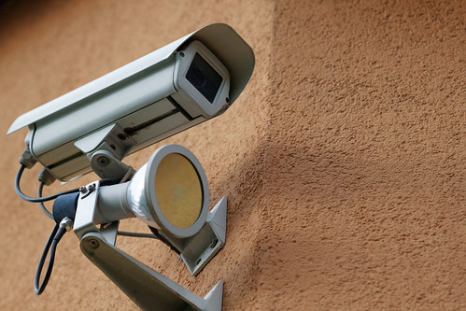
Ayerst (Inspector of Taxes) v C & K (Construction) Ltd [1976]
On insolvency, company assets are impressed with a statutory trust
Assets must be applied in accordance with insolvency legislation.
It means: - assets are no longer freely disposable - they must be used only for statutory purposes
It aims to: - prevent directors or creditors from bypassing insolvency rules - reinforces the collective nature of insolvency proceedings
This Photo by Unknown Author is licensed under CC BY

Slide 6

The Statutory Trust (Ayerst Principle)
Ayerst (Inspector of Taxes) v C & K (Construction) Ltd
Effect of insolvency:
Company retains legal title over its assets
Beneficial interest shifts for creditor benefit
Assets available only if:
Company has beneficial ownership
Excluded assets:
Retention of title goods (Aluminium Industrie Vaassen BV v Romalpha Aluminium Ltd)
Trust property
Valid security intersts

Slide 7

The Role of the Office Holder
Upon Insolvency:
Director’s powers cease and an office holder assumes control
Duties:
Act in creditor’s interests
Respect existing propriety rights
Take assets ‘as found’.

Slide 8

Office-Holder ‘takes as found’
On insolvency, an office-holder takes the company’s assets as they exist
Insolvency does not improve the company’s property rights
The office-holder cannot acquire greater rights than the company has.
Assets taken are subject to all existing rights and limitations.
E.g., If an asset is subject to a valid security interest, it remains that way.

Slide 9

Mandatory Nature of Insolvency Law
No contracting out.
Statutory provisions override private agreements
Statutory ranking governs distribution
Court supervision:
Frequent litigation over asset recovery, priority disputes and office-holder decisions

Slide 10
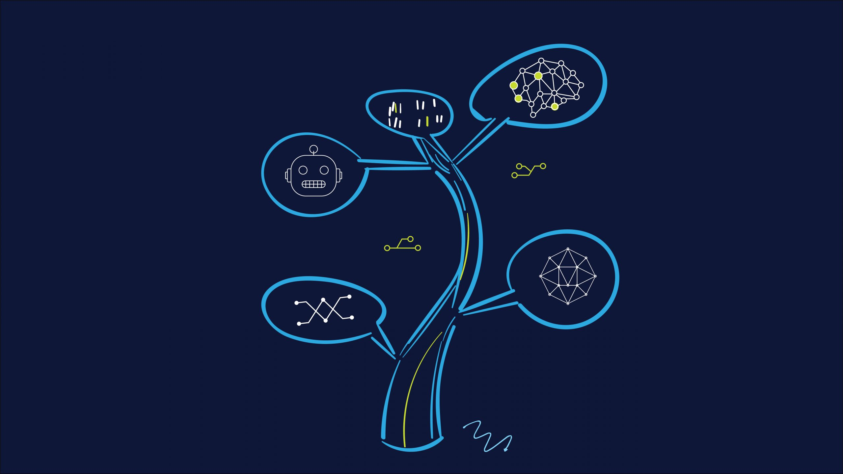
Historical Evolution
Punitive Origins - Roman and Greek practices - Medieval Lex Mercatoria -1542 Statute of Bankrupts
Early focus: - Individual wrongdoing - Severe punishment - No collective structure
17th to 19th centuries: - Bankruptcy courts established - Formal procedures emerge - Introduction of receivership - Gradual move toward regulation
Modernisation and rescue culture: - Insolvency Act 1986 - Enterprise Act 2002 - Corporate Insolvency and Governance Act 2020
Influenced by Cork Report (1982)

Slide 11
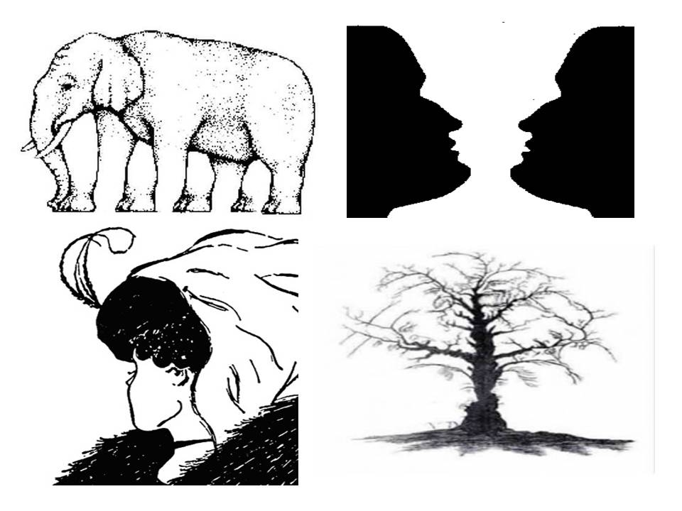
The Enterprise Act 2002
Pre-2002 position: - Insolvency carried reputational stigma
Entry into procedure signalled failure
Liquidation dominant outcome
Post-2002 reform: - Administration strengthened as a primary procedure - Restricted administrative receivership - Promoted rescue culture

Slide 12

Corporate Insolvency and Governance Act 2020
Introduced in the context of Covid-19
Key measures:
Temporary suspension of wrongful trading liability
Restrictions on statutory demands & winding-up petitions
Introduction of restructuring plan
New stand alone moratorium

Slide 13

Contemporary Pressures on Insolvency Law
Ongoing policy balance: - creditor protection vs business rescue
Emerging challenges: - globalisation - cross-border insolvency - digital assets & new payment systems - post-Brexit autonomy
Strategic concern: - maintaining the UK’s attractiveness to investors

Slide 14
Summary
Understand the core principles of the insolvency law
Understand its historical context
Think about its place today

Slide 15

Next Lecture: Insolvency continued

